Slide 1

Sampling techniques By Dilipan kumar Rowan Xavier Angela Carol Fernandez Sivaranjini S

Slide 2
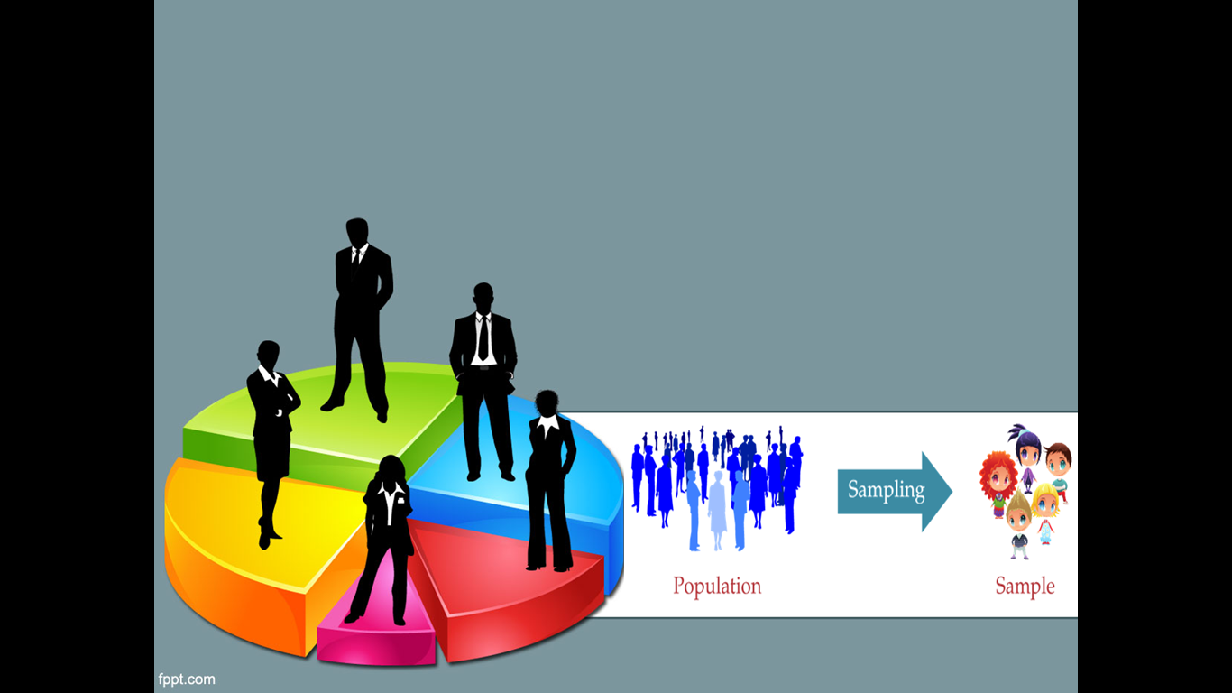
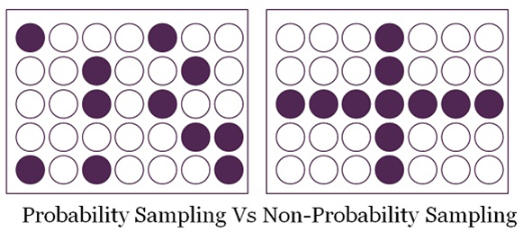
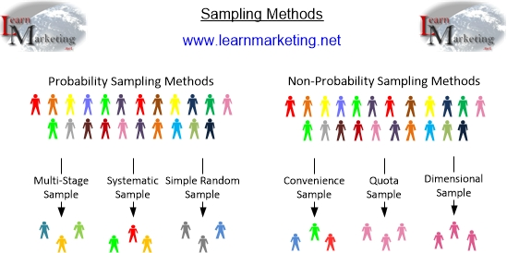
CLASSIFICATION
FPPT.com

Slide 3
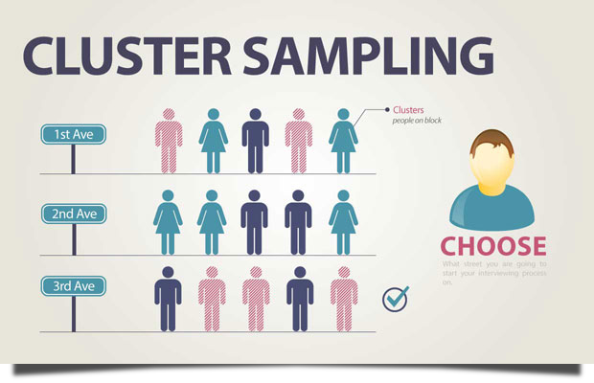
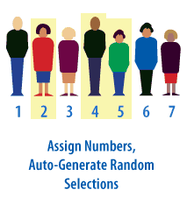
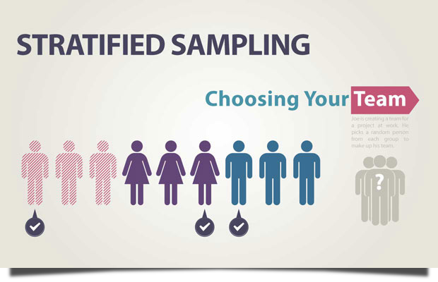
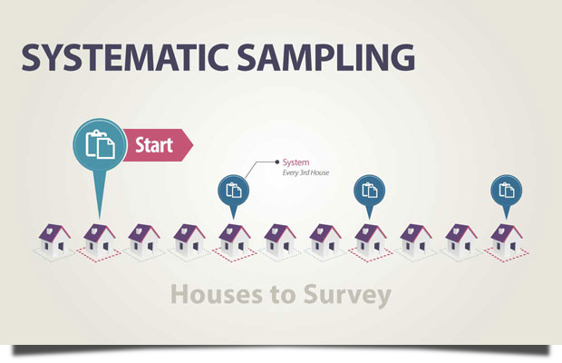
SIMPLE RANDOM SAMPLING
Random Sampling Technique

Slide 4
CONVENIENCE SAMPLING
Convenience sampling is a specific type of non-probability sampling method where the sample is collected from population members(people) who are conveniently available to participate in study.
This method of sampling is also known as grab sampling or availability sampling.
Advantages:
Ease of availability.
Saves time
Economically efficient.
Disadvantages:
Results cannot be generalized.
High possibility of error.
Examples:
Facebook poll
Asking for volunteers at the mall
Asking reviews of a movie.

Slide 5
SNOWBALL SAMPLING
It is a sampling where the research participants recruit other participants for a test study. It is used where potential participants are hard to find.
It may be extremely difficult or cost prohibitive to locate respondents in these situations.
Snowball sampling relies on referrals from initial subjects to generate additional subjects.
Advantages:
This technique allows the researcher to reach population which are otherwise impossible to reach.
Disadvantages:
As the people involved in the sampling have similar traits it can end up being biased.
Real Time Application:
While doing a study on people who are affected by drug use , the potential participants may be vary of coming forward and revealing their identity , however in such cases the other participants can inform them about the benefits of the study and also reassure them of their confidentiality and encourage them to come forward.

Slide 6
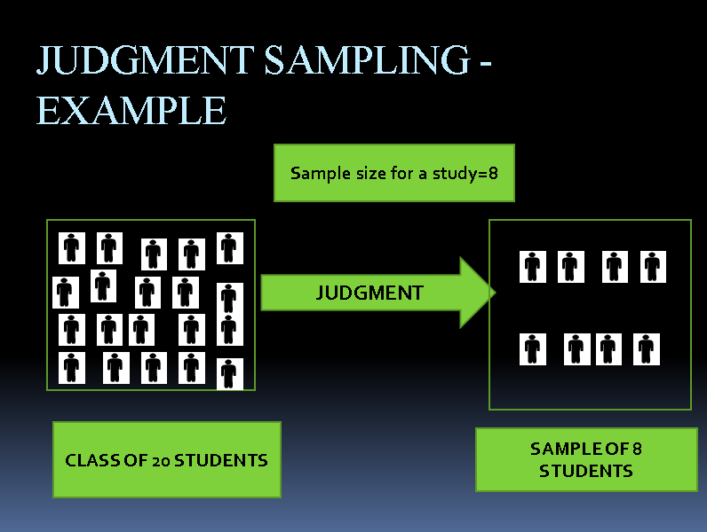
PURPOSIVE SAMPLING
Purposive sampling (also known as judgment, selective or subjective sampling) is a sampling technique in which a researcher relies on his or her own judgment when choosing members of population to participate in the study
Advantages:
cost-effective
Time-effective
Disadvantages:
Vulnerability to errors
Low level of reliability
High levels of bias.

Slide 7
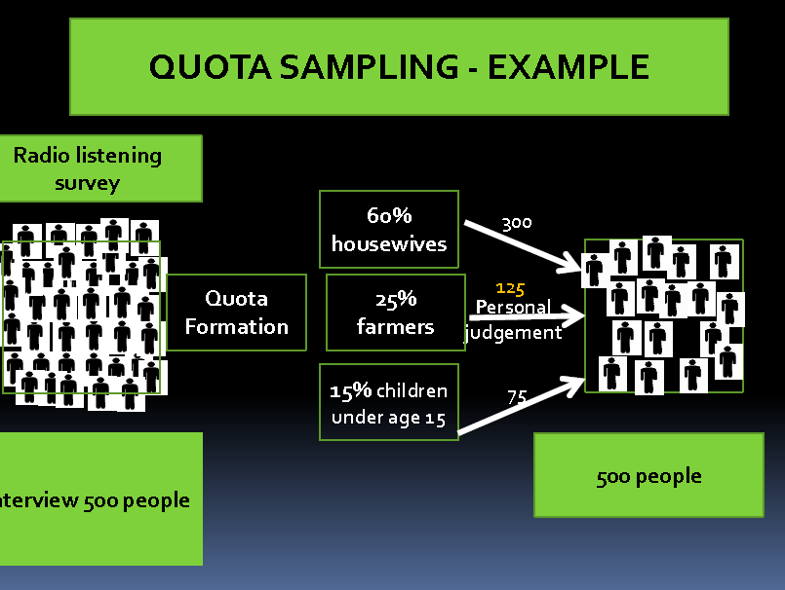
QUOTA SAMPLING
Most commonly used Non probability sampling which are based on pre-specified quotas regarding demographics, attitudes, behaviors, etc
Within a quota selection depends on personal judgment
Advantages:
Easy to manage, quick
Used in Public opinion polls
Disadvantages:
Personal Prejudices and bias
Dependent on subjective decisions

Slide 8
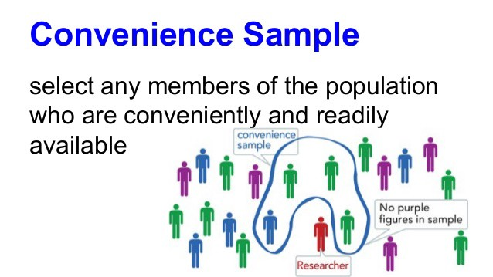
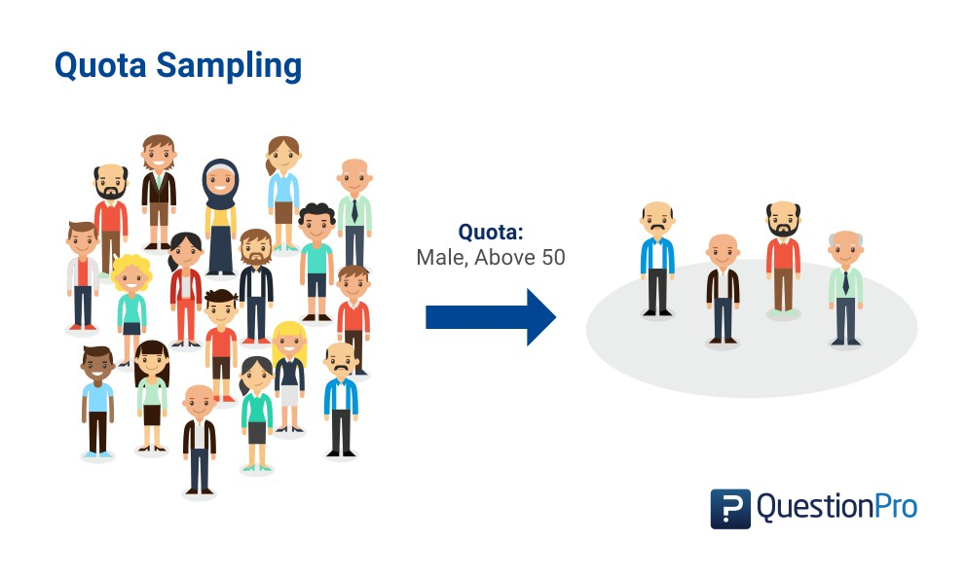
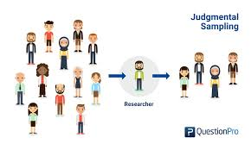
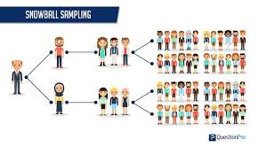
Non - Random Sampling Technique

